Slide 1
The Current Federal Policy Landscape and Its Impact on the Future of IME​
PRESENTATION FOR
Independent Medical Education and Grants Summit
September 20, 2022

Slide 2
Andrew Rosenberg, JD​
Senior Advisor, CME Coalition​
Founding Partner, Thorn Run Partners (TRP)​
25+ years of experience as a lobbyist, Capitol Hill staffer, and health policy expert​
Served on the committee (Senate Health, Education, Labor and Pensions) and personal staffs of Senator Edward M. Kennedy (D–MA)

Slide 3
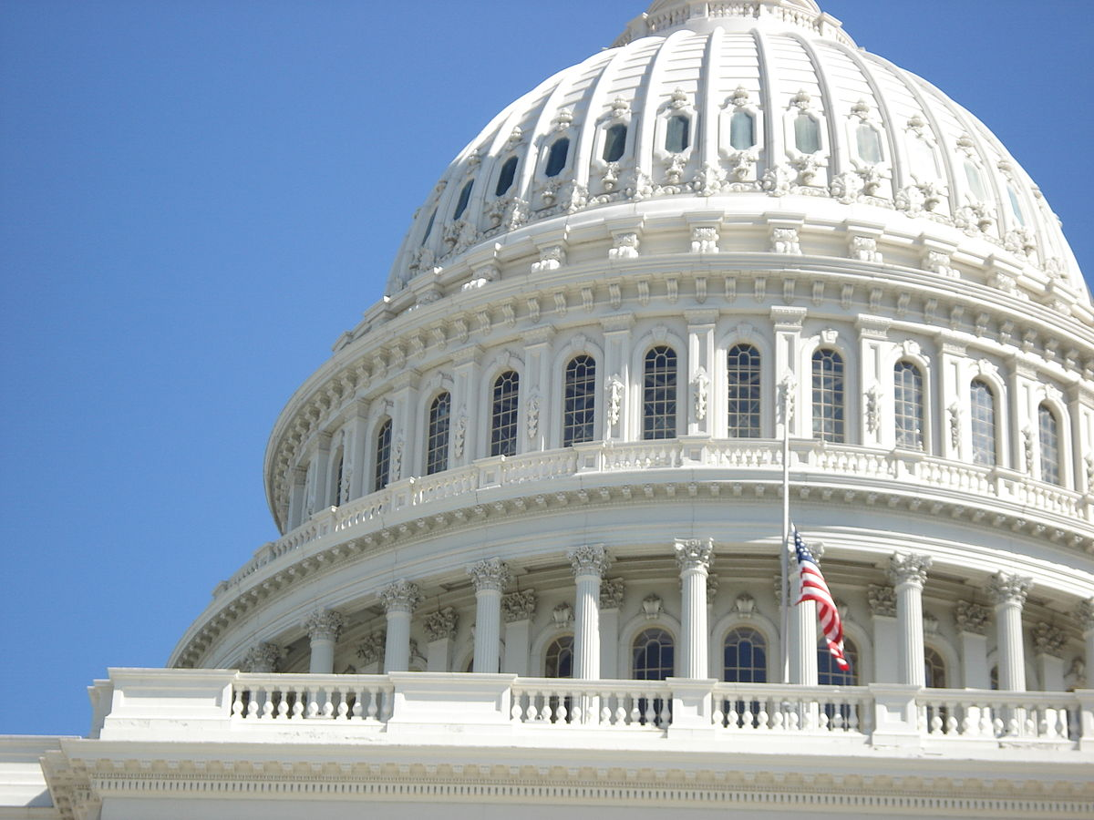
Our Discussion Includes…
Presentation Overview
State of Play for Federal Health Policy
A Look at Health Policy End-of-Year Policies
Other Potential Action for Fall 2022
Beyond 2022: Longer Term Trends and Priorities
Midterm Elections
Historical Context
Where Things Stand
CMS RFI on CME in the Medicare QPP
HHS OIG Advisory Opinion
Proposed FAQs for CME Exclusion Rules for Faculty with Ownership Stakes in Startups
The FDA
On Opioids and CME
On Dietary Supplement CME
State Updates
CME Policymaking on Capitol Hill
Federal Policy and Its Impact on the Future of IME​

Slide 4
A Look at Health Policy End-of-Year Policies
Congressional staff are working behind the scenes to conceptualize a potential health care package before the end of 2022, though many competing priorities remain in flux. Based on the current legislative environment, these policies include:
 | Policy | Description
Some Action Highly Likely | FY 2023 Appropriations Expires Sept. 30, 2022 | While leadership is hopeful that the appropriations process can move swiftly for fiscal year (FY) 2023, it is all but certain that a CR will be needed to provide lawmakers more time to address government funding and expiring programs while avoiding a government shutdown. Many other expiring programs are likely to be wrapped into this prospective CR.
 | FDA User Fees Expires Sept. 30, 2022 | The House and Senate were on track to reach an agreement between their Food and Drug Administration (FDA) user fee draft bills before the current user fee programs expire, though disagreements have derailed the process. While the House passed expansive legislation to address user fee reauthorization, a “skinny” reauthorization bill is more likely to become law.
Action Still Unclear | Sequestration Policies 6% total cut by Jan. 1, 2023 | Statutory Pay-as-you-go (PAYGO) and Medicare sequestration would lead to a 6 percent cut to physician practices. These cuts would be harmful to most lawmakers’ areas of interest, and Congress has never allowed PAYGO to be implemented. However, the Medicare sequester increased from 1 percent to 2 percent on July 1 and further discussion has been minimal.
 | FMAP in the Territories Expires December 13, 2022 | The federal medical assistance percentage (FMAP) for U.S. territories will revert from 83 percent to 55 percent in the American Samoa, the Commonwealth of the Northern Mariana Islands (CNMI), Guam, and the U.S. Virgin Islands unless extended in a continuing resolution (CR). While discussion surrounding this issue has been limited, allowing this funding to lapse is unlikely.
 | Telehealth Flexibilities Will Expire Dec. 31, 2022 | Many telehealth policies have been extended throughout the pandemic. Several bills in this Congress include provisions that would maintain prescribing flexibilities. Click here for TRP’s comparison of telehealth extension bills. While a consensus has yet to be reached regarding various telehealth policies, there is bipartisan support for these initiatives.

Slide 5
Other Potential Action for Fall 2022
Many policies that Congress chooses to extend to implement before the December holiday break will likely be wrapped into a larger package. Other policies that may be considered include:
Medicaid FMAP for Territories
Behavioral Health Package
Pandemic Preparedness
Since the end of 2019, the FMAP for the territories has been increased from the statutory 55 percent to 76 percent for Puerto Rico and 83 percent for the other territories.
Most recently, this extension was included in the 2022 omnibus.
It is highly likely that Congress renews the enhanced federal medical assistance percentage.
Current FMAP enhancements expire December 13, 2022.
In June, the House passed the Restoring Hope for Mental Health and Well-Being Act of 2022.
However, the Senate Finance and Health, Education, Labor, and Pensions (HELP) Committee is working on larger reforms with new Medicaid and Medicare policies.
Senate Finance has released two discussion drafts targeting youth and tele-mental health and expects to produce legislation related to telehealth care parity, access to care, and workforce issues.
Senate HELP Committee Ranking Member Richard Burr (R-NC) views the Prepare for and Respond to Existing Viruses, Emerging New Threats and (PREVENT) Pandemics Act as a legacy issue as he retires after the 116th Congress.
The legislation has strong bipartisan support and passed through the HELP Committee.
Burr may push this bill before he retires.

Slide 6
Beyond 2022: Longer Term
Trends and Priorities
The likelihood of movement on these policy priorities will depend upon the outcome of the 2022 midterms, real world events, and emerging trends.
Republican Priorities
Bipartisan Priorities
Democratic Priorities
Oversight.
CMS payments/ fraud
FDA’s accelerated approval pathway outcomes
COVID-19 relief bills
PBM transparency
Medicare reform.
Expanding MA
Value-Based Payments in Part B
Access to drugs.
Reducing prior authorization requirements
Protecting intellectual property
Business-friendly drug development incentives.
Behavioral/ mental health infrastructure.
Pandemic preparedness legislation.
Electronic health records & Interoperability.
SUPPORT Act reauthorizations.
Oversight.
Telehealth
ARPA-H
340B
Provider shortages.
Inflation Reduction Act (IRA) implementation.
Federal Trade Commission (FTC) and antitrust.
Patent policies.
MA oversight.
Medicare dental coverage.
Medicaid expansion.
Abortion Coverage.
Drug pricing.

Slide 7
Midterm Elections: Historical Context
Midterm Polling & Approval Ratings​
Generic ballot polling has skewed Democratic in recent midterm cycles but looks better for GOP this cycle.​
Recent generic ballot leads for Republicans suggests the GOP could be positioned for double digit gains in the House.
Historically, the sitting President’s approval rating has been highly correlated to their party’s success in the midterms.
As President Biden’s approval ratings hover in the low-40s, this could bode poorly for congressional Democrats in the 2022 election.
Cycle​ | President​ | Pres. Approval​ | Early Generic Ballot Margin ​ | House Results​ | Senate Results​
1982​ | Ronald Reagan​ | 42%​ | R+0.3​ | D+26​ | R+1​
1986​ | Ronald Reagan​ | 63%​ | D+8.3​ | D+5​ | D+8​
1990​ | George H.W. Bush​ | 58%​ | D+10​ | D+8​ | D+1​
1994​ | Bill Clinton​ | 46%​ | D+2​ | R+52​ | R+8​
1998​ | Bill Clinton​ | 66%​ | D+7.7​ | D+5​ | EVEN​
2002​ | George W. Bush​ | 63%​ | D+6.7​ | R+8​ | R+2​
2006​ | George W. Bush​ | 38%​ | D+8.0​ | D+30​ | D+6​
2010​ | Barack Obama​ | 45%​ | D+2.9​ | R+63​ | R+6​
2014​ | Barack Obama​ | 44%​ | D+1.9​ | R+13​ | R+9​
2018​ | Donald Trump​ | 41%​ | D+1.9​ | D+41​ | R+2​
2022​ | Joe Biden​ | 41.2%​ | R +0.2​ | ???​ | ???​

Slide 8
Midterm Elections: Where Things Stand
Biden Approval Ratings
Polling
Top Issues Moving the Electorate
Inflation/Economy
Border Security/Immigration
Crime/Public Safety
Roe v. Wade
Republicans have maintained a consistent lead in generic congressional ballot polling in 2022, which typically skews Democratic. While Republicans are well positioned for double-digit gains in the House, polling data suggests Democrats do have a chance to maintain control of the Senate.
Despite a string of recent policy wins, President Biden has been mired by approval ratings that are hovering in the low 40s — a factor that should bode well for the GOP heading into November
Former President Donald Trump

Slide 9
CMS: RFI on CME in the Medicare Quality Payment Program
The Centers for Medicare and Medicaid Services (CMS) proposed its CY 2023 updates to the Medicare Physician Fee Schedule (PFS), which included a request for information (RFI) related to CME in the Medicare Quality Payment Program.
CMS solicited comments on whether to allow CME organizations to directly submit improvement activities for MIPS Value Pathways. This would, subsequently, require creating a new type of third-party intermediary.
The RFI also sought feedback on the value of the implementation of policies to approve CME organizations or accreditation entities as third-party intermediaries.
The Accreditation Council for Continuing Medical Education (ACCME) suggested, in its public comments submitted to CMS, that data collection be conducted through the Program and Activity Reporting System (PARS) system.
The ACCME claims that doing so provides accredited CME providers with the ability to designate a CME course as an improvement activity and report physician completion records, which would then be reported to CMS.
Context…
The CME Coalition previously championed an effort that resulted in the creation of a mechanism in the Merit-based Incentive Payment (MIPS) System that allows physicians to receive higher reimbursement rates under Medicare if, among other items, they register and complete quality improvement CME.

Slide 10
CMS: RFI on CME in the Medicare Quality Payment Program
The CME Coalition submitted comments on this proposal, expressing strong support for the addition of national CME accrediting organizations and providers as new third-party intermediaries able to directly report clinician completion of accredited CME and/or Maintenance of Certification (MOC) improvement activities for the MIPS Value Pathways.
Offering Expertise
Reducing Clinician Burden
Improving Patient Care
Because CME providers are already guiding clinicians through this process, these organizations are well positioned to serve as a third-party intermediary to submit data on clinician completion of CME or MOC activities within the improvement activities performance category.
In designating CME providers as a third-party intermediary responsible for submitting such data on behalf of clinicians, clinician burden would be reduced as the reoccurring responsibility of navigating the submission process would be eliminated.
Reducing clinician reporting burden in this regard allows clinicians to focus on improving patient care, which can be utilized to place a heightened focus on health equity, inclusion of patient voices, shared decision-making, and care coordination — each of which are areas of priority for CMS.

Slide 11
HHS OIG Advisory Opinion
On June 29, 2022, the Department of Health and Human Services (HHS) Office of Inspector General (OIG) released Advisory Opinion No. 22-14.
The Advisory Opinion highlights fraud and abuse considerations for provider-sponsored continuing education (CE) programs.
The Advisory Opinion evaluated CE programs sponsored by an ophthalmology practice that specializes in cataract and refractive surgery in coordination with local optometrists, many of whom have co-management relationships with the ophthalmology practice.
OIG acknowledged in this June 2022 AO that “CE programs are a mainstay for physicians and other licensed practitioners to update their technical knowledge and skills and to learn about new or modified diagnostic and treatment options.”
The Advisory Opinion does not change OIG’s historic position that grants by Manufacturers to independent, accredited education providers display minimal risk of fraud and abuse when such arrangements are structured to comply with:
The 2003 OIG Compliance Program Guidance for Pharmaceutical Manufacturers;
The 1997 guidance from the FDA; and
The ACCME Standards for Independence and Integrity.

Slide 12
Proposed FAQs for CME Exclusion Rules for Faculty with Ownership Stakes in Startups
Over the last two months, the CME Coalition convened several working group sessions to identify concerns and propose a remedy to the ACCME regarding its current guidance prohibiting shareholders of certain private companies from participating in CME as faculty.
During these calls, our working group members identified several recommended solutions to the current exclusion language and drafted preliminary, clarifying FAQs language which was then presented to the ACCME for their consideration.
The ACCME said that it did not believe it workable to shift the threshold for being ineligible from investigational new drug (IND) filing to the initiation of a phase 2 trial, as we had suggested.
The ACCME claimed that, in doing so, it would be changing rules and introducing new caveats — across the professions — for an issue that affects a small number of biomedical startup founders and beneficiaries AND for a relatively short period of time (while phase 1 is going on and phase 2 has not been started).
While the CME Coalition and the ACCME have yet to arrive at a consensus on a path forward, we are continuing to engage on this matter.
Dr. Graham McMahon, President and CEO of the ACCME, has agreed to join the CME Coalition to discuss the intricacies of this issue and answer any questions that our members might have regarding our proposed FAQs.

Slide 13
Latest Action: The FDA on Opioids and CME
FDA Holds Workshop to Identify Key Competencies for Opioid Prescriber Education
On April 4 and 5, 2022, the FDA, in conjunction with the Duke-Margolis Center for Health Policy, convened a session on opioid and prescriber education, specifically focusing on identifying key competencies in this regard.
Last year, the FDA and the Duke-Margolis Center for Health Policy held a workshop entitled “Reconsidering Mandatory Opioid Prescriber Education Through a Risk Evaluation and Mitigation Strategy (REMS) in an Evolving Opioid Crisis” to seek stakeholder comment on aspects of the current opioid crisis that could be mitigated in a measurable way by requiring mandatory prescriber education as part of a REMS.
The CME Coalition submitted public comments to communicate that required Opioid REMS is not a workable solution to the opioid crisis.
FDA Files Notice and Requests Comment on Potential Modification to Opioid Analgesic REMS
Recently, the FDA issued a notice (press release) detailing a potential modification to the Opioid Analgesic Risk Evaluation and Mitigation Strategy (REMS) which would require that prepaid mail-back envelopes be dispensed to patients and education on safe disposal of opioid analgesics be provided in outpatient settings.
The FDA notes that such a requirement could reduce nonmedical use, accidental exposure, and overdose of unused opioid analgesics as it would limit the number of such opioids present in patients’ homes.
The FDA anticipates that this requirement would lower the overall number of individuals who develop an addiction to opioids.

Slide 14
The FDA: CME for Dietary Supplements
In June, the FDA announced a new initiative related to dietary supplements.
The resources accompanying the announcement of the Supplement Your Knowledge initiative include information about the potential benefits and risks associated with dietary supplements — including vitamins, minerals, and herbs.
The FDA, along with the American Medical Association (AMA), created a CME program to aid physicians and other health care professionals in:
Understanding how dietary supplements are regulated;
Providing information for patients regarding their use; and
Recognizing and reporting adverse events to the FDA.
Reports have revealed that the 2021 passing of Lori McClintock, the wife of Rep. Tom McClintock (R-CA), was attributed to dehydration ultimately caused by the ingestion of a dietary supplement.
This revelation will likely drive Congressional intention on the subject, placing a heightened focus on the safety and efficacy of dietary supplements.
Details
The free CME program includes three videos and companion education materials.
Physicians who complete the CME course can earn 0.50 AMA PRA Category 1 Credit on the AMA Ed Hub.

Slide 15
Actions Underway by States
Illinois
Massachusetts
Other States
Beginning January 1, 2023, all health professionals in Illinois will be required to complete a one-hour CME course on implicit bias awareness training.
Health professionals who possess more than one relevant health license in the state of Illinois will be required to complete this training just once.
Beginning June 1, 2022, the Massachusetts Board of Registration in Medicine is requiring that both applicants for initial physician licensure as well as licensees renewing physician licensure complete a CME requirement of 2.00 credits on the topic of implicit bias in health care.
Washington passed a bill that added health equity training to the CME requirements for health care providers.
The California Senate passed legislation to require CME for physicians covering TGI care.
Oregon and New York have also considered the addition of CME requirements for certain provider types as well as an uptick in required CME hours.

Slide 16
CME Policymaking on Capitol Hill
Bill Name | Topic | Original Sponsor | Date Introduced | Key Provisions
Improving Access to Health Care in Rural and Underserved Areas Act (H.R. 7383) | CME for Primary Care | Rep. Susie Lee (D-NV) | 4/5/2022 | Directs HRSA to award up to 100 grants for federally qualified health centers or rural health clinics to provide accredited continuing medical education to their primary care providers.
Improving Access to Health Care in Rural and Underserved Areas Act (S. 201)​ | CME for Primary Care​ | Sen. Jacky Rosen (D-NV)​ | 2/3/2021​ | Directs HRSA to award up to 100 grants for federally qualified health centers or rural health clinics to provide accredited continuing medical education to their primary care providers.​
Expressing the sense of the House of Representatives that the United States recognizes the mounting personal and financial burden of diet-related disease in the United States and calls on medical schools, graduate medical education programs, and other health professional training programs to provide meaningful physician and health professional education on nutrition and diet. (H.Res. 1118) | Nutrition and Diet CME | Rep. James McGovern (D-MA) | 5/16/2022 | This resolution expresses support for activities to ensure that health professional training programs (e.g., medical schools, residencies, and fellowships) incorporate substantive training in nutrition and diet.

Slide 17
ON BEHALF OF THE CME COALTION, WE HOPE THIS WAS INFORMATIVE.
QUESTIONS?
THANK YOU
Andrew Rosenberg
(202) 688-0225
arosenberg@thornrun.com

