Slide 1
MACRA/MIPS – CME and Improvement Activities
How they are all connected

Slide 2
CME Coalition Hot Topics
Coalition Hot Topics
Government updates and D.C. happenings
What should providers be aware of?

Slide 3
Quality Payment Program

Slide 4
MIPS Providers for 2019
Applicable Providers
Exemptions
Physicians
MD, DO
Dentist
Podiatrist
Optometrist
Chiropractor
• Physician Assistants
• Nurse Practitioners
• Clinical Nurse Specialists
• Certified Registered Nurse Anesthetists
Clinicians at or below the Low Volume Threshold (<$90K Medicare Billing or 200 patients)
Eligible Clinicians newly enrolled with Medicare
APM Qualified Participants (QPs)
APM Partial QPs who choose not to report
Temporary Excluded Credentials
Certified Nurse Midwife
Clinical Social Worker
Clinical Psychologist
Registered Dietician or Nutritionist
Physical or Occupational Therapist
Speech-Language Pathologist
Audiologist
CMS, Medicare Program; Merit-Based Incentive Payment System (MIPS) and Alternative Payment Model (APM) Incentive under the Physician Fee Schedule, and Criteria for Physician-Focused Payment Models, Final Rule, Released to Office of Federal Register, October 14, 2016. CMS, Medicare Program: CY 2018 Updates to the Quality Payment Program, Final Rule, Federal Register, October 23, 2017.

Slide 5
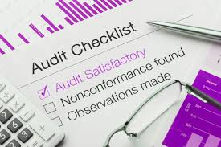
Breakdown
Quality (50%)
6 measures (1 outcome measure, readmissions)
450+ potential measures
Cost (10%)
Based on minimum of 20 case
Advancing Care Information (25%)
90 days of data
(CEHRT 2015 10% Bonus)
Exemptions (non patient facing, hospital based, ASC based)
Improvement Activities (15%)
112 Activities

Slide 6
Value Based Reimbursement
Impact to healthcare providers

Slide 7
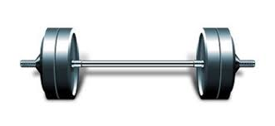
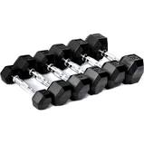
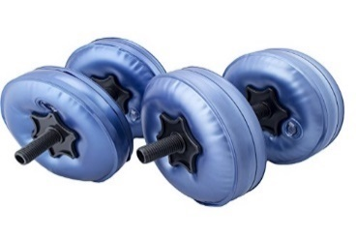
Improvement Activities
More than 100 Improvement Activities
Range from Participation in PCMH or Registry to Extra Office Hours
Groups of 15 or More | 2 high weighted activities | 1 high weighted and one medium weighted activities | 4 Medium weighted activities
Groups of 15 or Fewer | 1 high weighted activities |  | 2 medium weighted activities

Slide 8
MACRA and CME the Importance of Improvement Activities
Title: Completion of an Accredited Safety or Quality Improvement Program Activity
Description: Completion of an accredited performance improvement continuing medical education program addresses performance or quality improvement according to the following criteria:
The activity must address a quality or safety gap that is supported by a needs assessment or problem analysis, or must support the completion of such a needs assessment as part of the activity;
The activity must have specific, measurable aim(s) for improvement;
The activity must include interventions intended to result in improvement;
The activity must include data collection and analysis of performance data to assess the impact of the interventions; and
The accredited program must define meaningful clinician participation in their activity, describe the mechanism for identifying clinicians who meet the requirements, and provide participant completion information.

Slide 9
Opportunity for CME
QI CME Improvement Activity
Supports collection of data
Contributes to Advancing Care Information Credit
Combined with other Improvement Activities
Data Registry, Claims data…..
Can contribute to 40% of the composite performance score for earning more than fee schedule reimbursement
Can also qualify for MOC Part 2 & 4
Involves your local QI Department or Office
We are teaching medical professionals how to utilize their own data for clinical quality improvement

Slide 10
ACCME’s step by step guide

Slide 11
Rockpointe’s Quality Payment Program (QPP) CME Improvement Activity Worksheet

Slide 12
Rockpointe’s Quality Payment Program (QPP) CME Improvement Activity Worksheet Cont.

Slide 13
Real World Scenarios
How would these CME activities qualify as CMS improvement activities?
Live meeting with 200 learners that includes ARS
Hands-on preceptorship program
Internet activity, enduring material (Video based)
Regularly scheduled series (i.e. Visiting Professorship Program- In hospital grand round meetings)

