Slide 1
Trump or Trumped: an Update on CME and Federal Policy
October 25, 2017

Slide 2
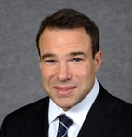
Andrew Rosenberg, JD, MP
Senior Advisor, CME Coalition
Founding Partner, Thorn Run Partners
25 years of experience as a lobbyist, Capitol Hill staffer and health policy expert
Thomas Sullivan
President Rockpointe, Inc., Potomac Center for Medical Education
Editor, Policy and Medicine, Life Science Compliance Update
Founding Member, CME Coalition

Slide 3
Disclaimer
The views expressed in this presentation represent our own opinions and those gleamed from discussions and work with attorneys.
This presentation does not represent legal advice.
We recommend you discuss many of your questions with your own attorneys.

Slide 4
Today’s Agenda
Update on the status of healthcare legislation and changes in Washington
MACRA Quality Payment Program and the 2018 QI CME Measure
Open Payments, State Gift Ban Legislation and CME
CME in tackling Opioid Crisis

Slide 5
Status of ACA Repeal/Replace? Repair?
4
ACA More Popular Now than Ever
But it is wounded and increasingly sabotaged
Rates expected to soar in 2018
No Consensus Replacement has yet Emerged
Bipartisan patch in the works, but it will be tricky

Slide 6
MACRA QPP (MIPS) – Improvement Activities

Slide 7
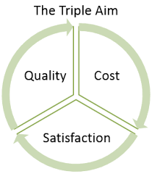
Value Based Care
Triple Aim
Improving the experience of care,
Improving the health of populations
Reducing per capita costs of health care
Should be Simple (but)
Insurance Company/Payor
Health System
Provider
Staff
Patient
Families

Slide 8
Information overload
We don’t like the word “Bundled”
Improving Quality is Confusing
We have
to move to Value-Based
Payment
Our Hospital revenues are declining
We need a new server
We must contain costs
The Federal Marketplace is imploding!
Compliance Reports are almost due
I don’t understand my condition
Our CEO says the future is in documenting with structured data
(?)
I can’t afford my meds
I’m not hitting my performance measures
We have to recruit 3 new physicians!
We need to issue the reg by Fall
The Internet is down
I can’t afford coverage!

Slide 9
Value Based Purchasing Industry Trends
MACRA – MIPS
676,722 clinicians $199-$321 million in ± adjustments in 2017
Decrease by 134,000 clinicians in 2018
MACRA – Advanced APMs
70,000-120,000 clinicians in 2017
5% lump sum incentive
A-APMs 2018
> than double with MSSP Track 1+
Aetna
Merck – Januvia and Janumet rebates for T2DM
Driven by treatment outcomes
Cigna
Sanofi and Amgen – Praluent and Repatha – Cholesterol PCSK9 inhibitors ~ $14K/year
Discounts linked to LDL reduction benchmarks
BCBS Plans VBP
1:5 dollars spent of $65BN directed towards VBP
Anthem (14 states), 58% VBP – 75% shared-savings contracts, 159 ACO contracts
BCBSMI – 1,500 PCMHs, 4,500 MDs, “Organized Sys. Of Care”
UnitedHealth Group
$49BN/year through VBP contracts (33%)
Goal to raise to $65Bn by 2018
Medicare Advantage
Seeking data on 4 categories of VBP
Included in MACRA A-APMs thresholds PY2019
Managed Medicaid
5 state approaches
MCOs used state developed VBP model
% of payments must be VBP
Evolving VBP over years
Multi-payer VBP alignment
State approved VBP pilots
Sources: CMS MACRA Final Rule; Forbes UHC Article, Aug. 4; Aetna Press Release, Oct 11, 2016; Fortune, Jun 21, 2016; UnitedHealth Group, May 25, 2017; Forbes, Anthem BC, Apr. 11, 2017; AIS Health, 2017 Blues Outlook, Dec. 29, 2016; UHC website, May 16, 2017; MA Call Letter; CHCS Brief, Feb. 2016

Slide 10
MACRA By The Numbers
31 times → Reasonable Cost Reimbursement
18 times → Risk
8 times → Meaningful Use
19 times → Resource Use or Efficiency
27 times → EHR/Technology to Manage, Measure and Report
171 times → Measures/Measurement
38 times → Quality Measures
103 times → Data
HR 2, 114th Congress, Medicare Access and CHIP Reauthorization Act, https://www.congress.gov/bill/114th-congress/house-bill/2/text

Slide 11
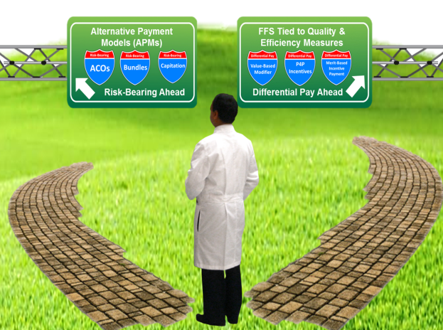
Quality Payment Program
Two Payment Paths
Alternative Payment Models (APMs)
Differential FFS based on measured performance (MIPS)

Slide 12
MACRA Payment Transition Strategy
1
2
3
4
MIPS – Penalty Avoidance
MIPS – Delayed Start
MIPS – Ready to Go
Advanced Alternative Payment Model
Options
Submit by Mar. 31, 2018
90 days of data between Jan. 1 and Oct. 2, 2017
1 Quality Measure,
1 Clinical Practice Improvement Activity, or
5 required Advancing Care Information measures
Submit by Mar. 31, 2018
90 days of data between Jan. 1 and Oct. 2, 2017
> 1 Quality Measure,
> 1 improvement activity, and/or
> 5 required Advancing Care Information measures
Submit by Mar. 31, 2018
“Full Year” of data
6 Quality Measures (1 outcome) – MIPS APM Groups report 15;
4 improvement activities; or 2 for small, rural, HPSA or non-patient facing
Required or up to 9 of advancing care information measures
Significant portion of Medicare patients or payments
Qualified Participant (QP) determination “snapshot” and inclusive
Driven by patient or payment thresholds
Requirements
APMs
MIPS APMs
Advanced APMs
CMS, Medicare Program; Merit-Based Incentive Payment System (MIPS) and Alternative Payment Model (APM) Incentive under the Physician Fee Schedule, and Criteria for Physician-Focused Payment Models, Final Rule, Released to Office of Federal Register, October 14, 2016

Slide 13
MIPS Composite Performance Score
Performance Year / Application Year | Quality Measures | Resource Use or Cost | Improvement Activities | Advancing Care Information
Description | Replaces CMS Physician Quality Reporting System (PQRS) | Replaces ACA Value-based Payment Modifier | New category of measurement; Medical Homes and NCQA PCSR receive full credit; 93 activities available | Replaces CMS EHR Incentive Programs f/k/a Meaningful Use;
Reporting Methods | Claims, CSV, Web Interface (for group reporting), EHR, Qualified Clinical Data Registry (QCDR) | Claims | Attestation, QCDR, Qualified Registry, EHR Vendor | Attestation, QCDR, Qualified Registry, EHR Vendor, Web Interface (groups only)
2017 / 2019 | 60% | 0%* | 15% | 25%
2018 / 2020 | 60% | 0%* | 15% | 25%
2019 / 2021 | 30% | 30% | 15% | 25%
*Measured for feedback only in 2017
CMS, Medicare Program; Merit-Based Incentive Payment System (MIPS) and Alternative Payment Model (APM) Incentive under the Physician Fee Schedule, and Criteria for Physician-Focused Payment Models, Final Rule, Released to Office of Federal Register, October 14, 2016. CMS, Medicare Program: CY 2018 Updates to the Quality Payment Program, Proposed Rule, Federal Register, June 30, 2017.

Slide 14
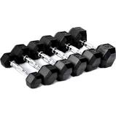
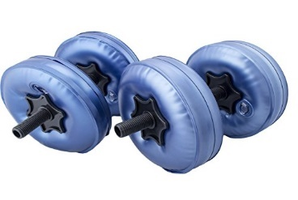
Improvement Activities
More than 90 Improvement Activities
Range from Participation in PCMH or Registry to Extra Office Hours
Groups of 15 or More | 2 high weighted activities | 1 high weighted and one medium weighted activities | 4 Medium weighted activities
Groups of 15 or Fewer | 1 high weighted activities |  | 2 medium weighted activities

Slide 15
MACRA and CME
7
CME Working Group
CME Coalition, ACCME, ACEHP, AMA, AAFP, CMSS…
Designed and submitted a proposed Improvement Activity for QI CME
Hundreds of public comments
New 2018 Improvement Activity Adopted by CMS in Proposed Rule in June
Final Rule due October 30, 2017

Slide 16
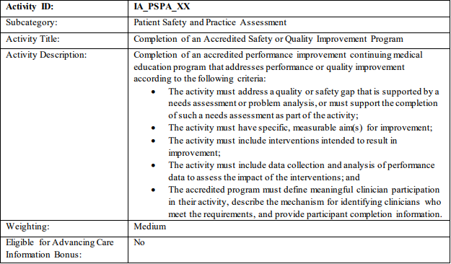
Performance/Quality Improvement CME
The QPP proposed rule includes an Improvement Activity for quality improvement (QI) CME:

Slide 17
Proposed Rule Language
Title: Completion of an Accredited Safety or Quality Improvement Program Activity
Description: Completion of an accredited performance improvement continuing medical education program addresses performance or quality improvement according to the following criteria:
The activity must address a quality or safety gap that is supported by a needs assessment or problem analysis, or must support the completion of such a needs assessment as part of the activity;
The activity must have specific, measurable aim(s) for improvement;
The activity must include interventions intended to result in improvement;
The activity must include data collection and analysis of performance data to assess the impact of the interventions; and
The accredited program must define meaningful clinician participation in their activity, describe the mechanism for identifying clinicians who meet the requirements, and provide participant completion information.

Slide 18
Opportunity for Education
QI CME Improvement Activity
Supports collection on data
Contribute to Advancing Care Information Credit
Combined with other Improvement Activities
Data Registry
Can contribute to 40% of the composite performance score for earning more than fee schedule reimbursement
Can also qualify for MOC Part 2 & 4
We are teaching medical professionals how to utilize their own data

Slide 19
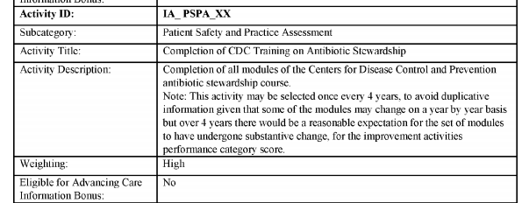
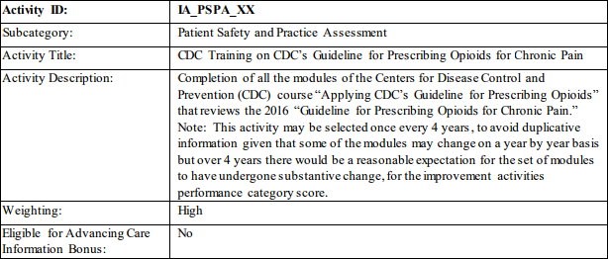
Other Educational Improvement Activities
2 Courses from CDC – Opioids and Anti Microbial Stewardship

Slide 20
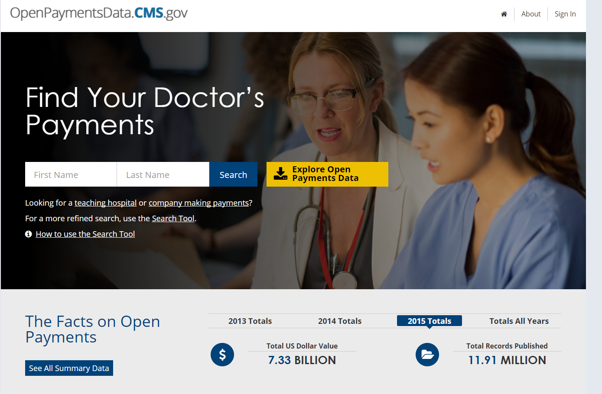
Open Payments and State Gift Ban Bills

Slide 21
Open Payments - CMS Guidance
11
In September 2016, CMS posted a revised FAQ on its Open Payments website regarding the reporting of CME-related payments.
The revised FAQ 8165 replaced an earlier FAQ on the same subject by providing greater specificity with regard to the exclusion of certain CME-related payments from Sunshine Act reporting that meet the standards outlined by CMS.

Slide 22
CMS FAQ 8165 (Question)
If an applicable manufacturer or applicable group purchasing organization (GPO) provides a payment or transfer of value to a continuing education provider to support a continuing education program but did not require, instruct, direct or otherwise cause (including, but not limited to, “encouraging” or “suggesting”) the continuing education provider to provide payments or transfers of value to physician speakers, is the payment considered reportable?

Slide 23
CMS FAQ 8165 (March 17- )
No, this payment or other transfer of value would not be reportable because it does not meet the definition of an indirect payment as defined at 42 U.S.C. § 403.902. For example, if an applicable manufacturer or GPO provides payments to a continuing education provider that are unrestricted and are intended to be used at the organization’s full discretion, and the organization chooses on its own volition to use those funds to pay physician speakers, the applicable manufacturer or applicable GPO would not be required to report the payments or transfers of value. These payments are not reportable regardless of whether the applicable manufacturer or applicable GPO learns that the payments went to covered recipient physicians and the identity of the physicians during the reporting year or by the end of the second quarter of the following reporting year because they would not meet the definition of an indirect payment. Key words: Open Payments, Sunshine Act, CME, Physician Fee Schedule

Slide 24
Practical Implications
So What Does This All Mean?

Slide 25
CME and Indirect Payment Rules
Certain CME-related payments are not indirect payments, and therefore, are “excluded from reporting” or are “outside the scope of the [Sunshine Act] rule”
When are CME-related payments excluded from reporting? The manufacturer must not:
“Condition… its financial” support on the “participation of particular” physician speakers or faculty;
“Select or pay” physician speakers or faculty directly;
Provide the CME provider with a “distinct, identifiable set of covered recipients to be considered as speakers”; or
Cause subsidized tuition fees to go to “specific physician attendees”

Slide 26
Practical Implications
Consider documenting how in each step of the CME lifecycle, the manufacturer has provided “full discretion” or has no control over content, speakers, faculty, attendees
Needs assessment, grant proposal, or RFP
Audience (e.g., specialties, institutions, hospitals, etc.)
Target geographic reach
Format/approach (e.g., live vs. web, outcomes vs. PI, etc.)
Faculty and speakers
Otherwise follow the ACCME SCS
Treatment of meals
Some LOA may prohibit funds for meals, speakers/faculty

Slide 27
State “Gift” Ban Roundup
Legislation – Proposed Rules introduced in at least 8 states to require disclosures or ban gifts between manufacturers and providers.
California, Maine, Massachusetts, Missouri, Nevada, New Jersey, and New York.
Maine Gift Ban
Exempts all CME from Ban
New Jersey
Proposed Rule with specific exemptions for accredited CME

Slide 28
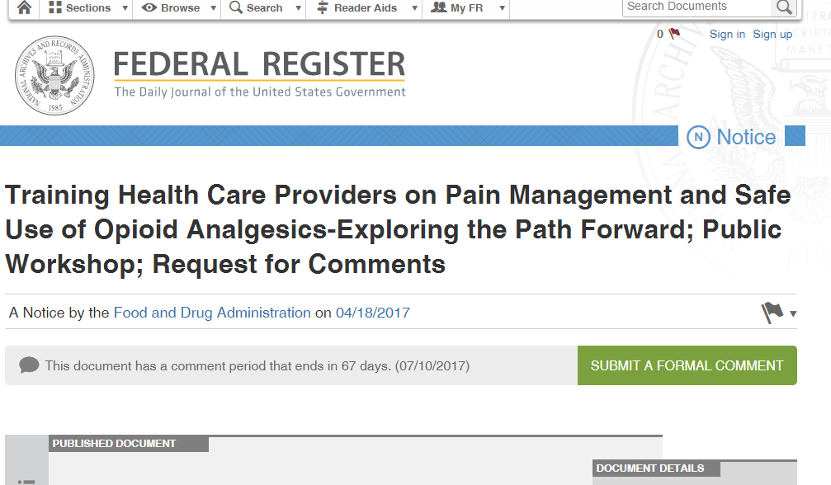
Opioid Education

Slide 29
Opioid REMS
19
Background on Opioid REMS and CME
FDA Opioid Prescriber Education Public Hearing
Opportunity for new MACRA Improvement Activity?

Slide 30
In an FDA Hearing and Up on Capitol Hill
“We are encouraged that the FDA sees CME as a valuable tool in combatting the opioids epidemic. Our members have developed hundreds of hours of innovative and creative pain education programs and have delivered them to hundreds of thousands of physicians.”
“As an incentive for prescribers to participate in opioid REMS, we recommend that the FDA encourage CMS to include opioid REMS as an improvement activity in the Quality Payment Program MIPS.”

Slide 31
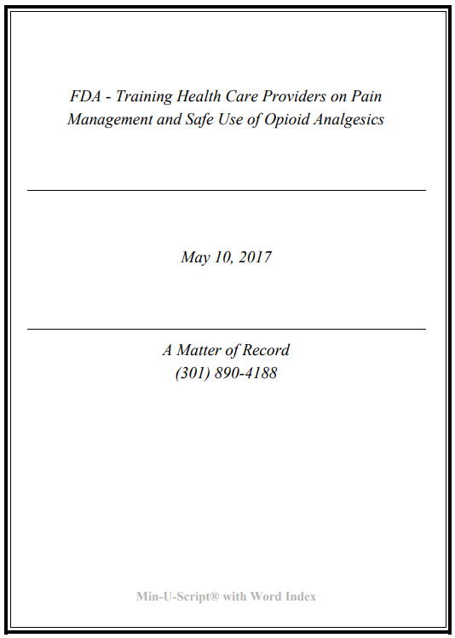
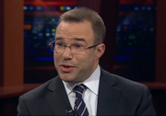
May 3-4 FDA Workshop

Slide 32
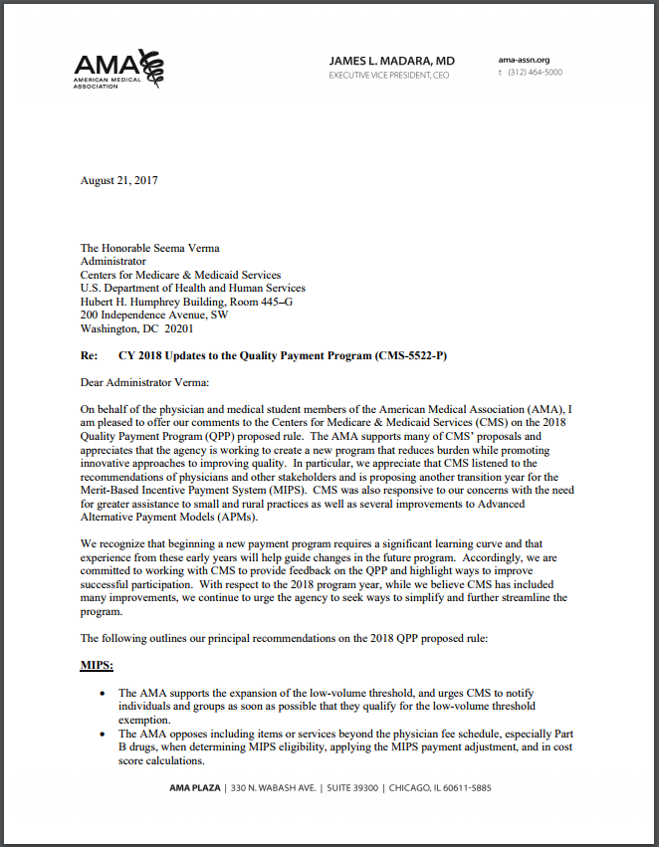
AMA Endorsement
In their comment on the proposed 2018 rule, the AMA suggests that “certified and accredited CMS courses in safe prescribing and/or pain management count for this IA.”

Slide 33
Summary
22
Affordable Care Act is still in play
Quality Improvement CE as an Improvement Activity
Open Payments may yet get it right
States are becoming for active and will require attention
FDA Sees an Important Role for CME in solving the opioid crisis
Encourage your organization to become active in advocacy

Slide 34
Questions and Answers

Slide 35
For More Information
CME Coalition www.cmecoalition.org
Andrew Rosenberg arosenberg@thornrun.com
Thomas Sullivan tsullivan@rockpointe.com

